Slide 1
Lab 1

Slide 2
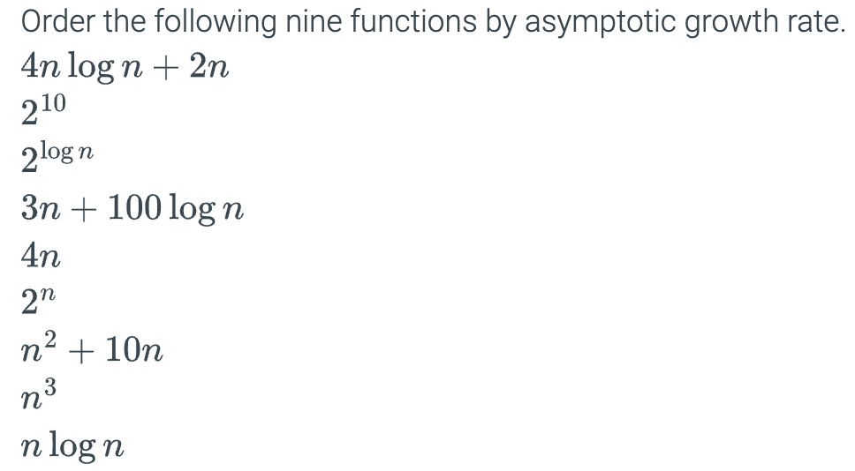
1.

Slide 3
2. Write a Python function named isValidPassword that takes two parameters: new_password (a string) and previous_passwords (a list). If new_password is an anagram of any of the three most recent previous_passwords, the function should return False. Otherwise, it should return True. Your function should run in O(n) time and use constant space, O(1). Consider handling any potential exceptions in your code.
Test your function with the following driver code and include this driver code within your script.
prev = ['abc','def', 'ghi', 'jkl', 'mno'] print(isValidPassword('xyz', prev)) # Should print True print(isValidPassword('bac', prev)) # Should print True print(isValidPassword(‘ihg', prev)) # Should print False
Note: Here, ‘ghi’, ‘jkl’, and ‘mno’ are the three most recent previous passwords.

Slide 4
Submission Instructions
Submit the following in iCollege:
Your response to Question 1 (YOUR_FULL_NAME_Lab1.docx/.txt)
Your solution/python script for Question 2 (YOUR_FULL_NAME_Lab1.py)
Due date/time: 24 hours after lab end time.
Notes:
- Be prepared to explain your solution/answer a few questions during the lab session.
- Lab attendance is mandatory; your submission will not be graded if you are absent.

